Slide 1
FOODPathS Webinar: How can education support a sustainable and healthy food system?
Gabriela Versteeg (EFFoST)
Notes:
Title slide

Slide 2
Establishing a branded network of university-driven local food eco-systems
Objectives
Map FS education & training programs in Higher Education Institutes (HEI) & professional training centres,
Establish an improved FS education and training program by helping to fill skills and knowledge gaps,
Establish a branded network of EU (university-driven) ecosystems to foster Food2030-inspired FS transitions.
Notes:
Is there a common ground, a common factor, which accelerates the sustainable food system transition?
What is the role the universities play on this, how do they relate to their ecosystem?
Research and Innovation (R&I) is a critical resource for the EU in the transformation towards Sustainable Food Systems for People, Planet & Climate. The prime condition for success is that a wide diversity of actors join forces in an EU Partnership – with a mission for change. In order to achieve this, it is important to link the international networks of institutions of higher education and research (HERI) working on food systems (FS) transition to the other stakeholders involved and invest in several types of knowledge transfer and training on food systems awareness, i.e., supporting the education programmes and competence building processes for food system transformation at all educational levels.
In WP5 of the FOODPathS project, our aim is to develop a sample charter for institutions of higher education and research that exemplify the role such organisations can play in catalysing sustainability in food systems.
Therefore, we investigate and learn from existing study programmes (curricula), accreditation systems and the organisation of HERI local ecosystems so that they can motivate staff, students, partners and citizens to foster Food2030 inspired FS transformations. These are relevant for local/regional communities and reveal the diversity of Member States solutions. This is also an imperative for consistency in EU Research, Innovation, Policy Advice and Education programmes.
The research of this study will be further used to help us to develop a food systems sustainability charter that focusses on the 4 aspects of what a HERI can do to build an enabling ecosystem for sustainable food systems:
Curricula development on sustainable food systems
Public procurement of sustainable food in their canteens and waste management
Community engagement around sustainable food
Industry/Research Partnership
This would conceptualise a branded network of EU HERI -driven local ecosystems that can foster improved FS education and training programmes, as well as public procurement and citizen engagement, across Member States.
The developed core principles, criteria and good practices for the accreditation of FS curricula will be combined into a branded network of exemplary universities, and as such forwarded to support better functioning of the European research and education invested by the FutureFoods Partnership.

Slide 3
Understanding Stakeholders needs
implementation of the innovations and need for specifically educated professionals
creating awareness
Industry
Primary/secondary schools
Higher Education & Research Institutes
Students and young researchers
Pathways to careers, ambitions and persoanl values
Nutritionists/society
focus on affordable, accepted and attainable
Policymakers
Stategic Research & Innovation Agenda
Research, Innovation, Policy Advice and Education programs
Living Labs & Start-ups, Parcs, cities
transfer of innovations and technologies, exploitation

Slide 4
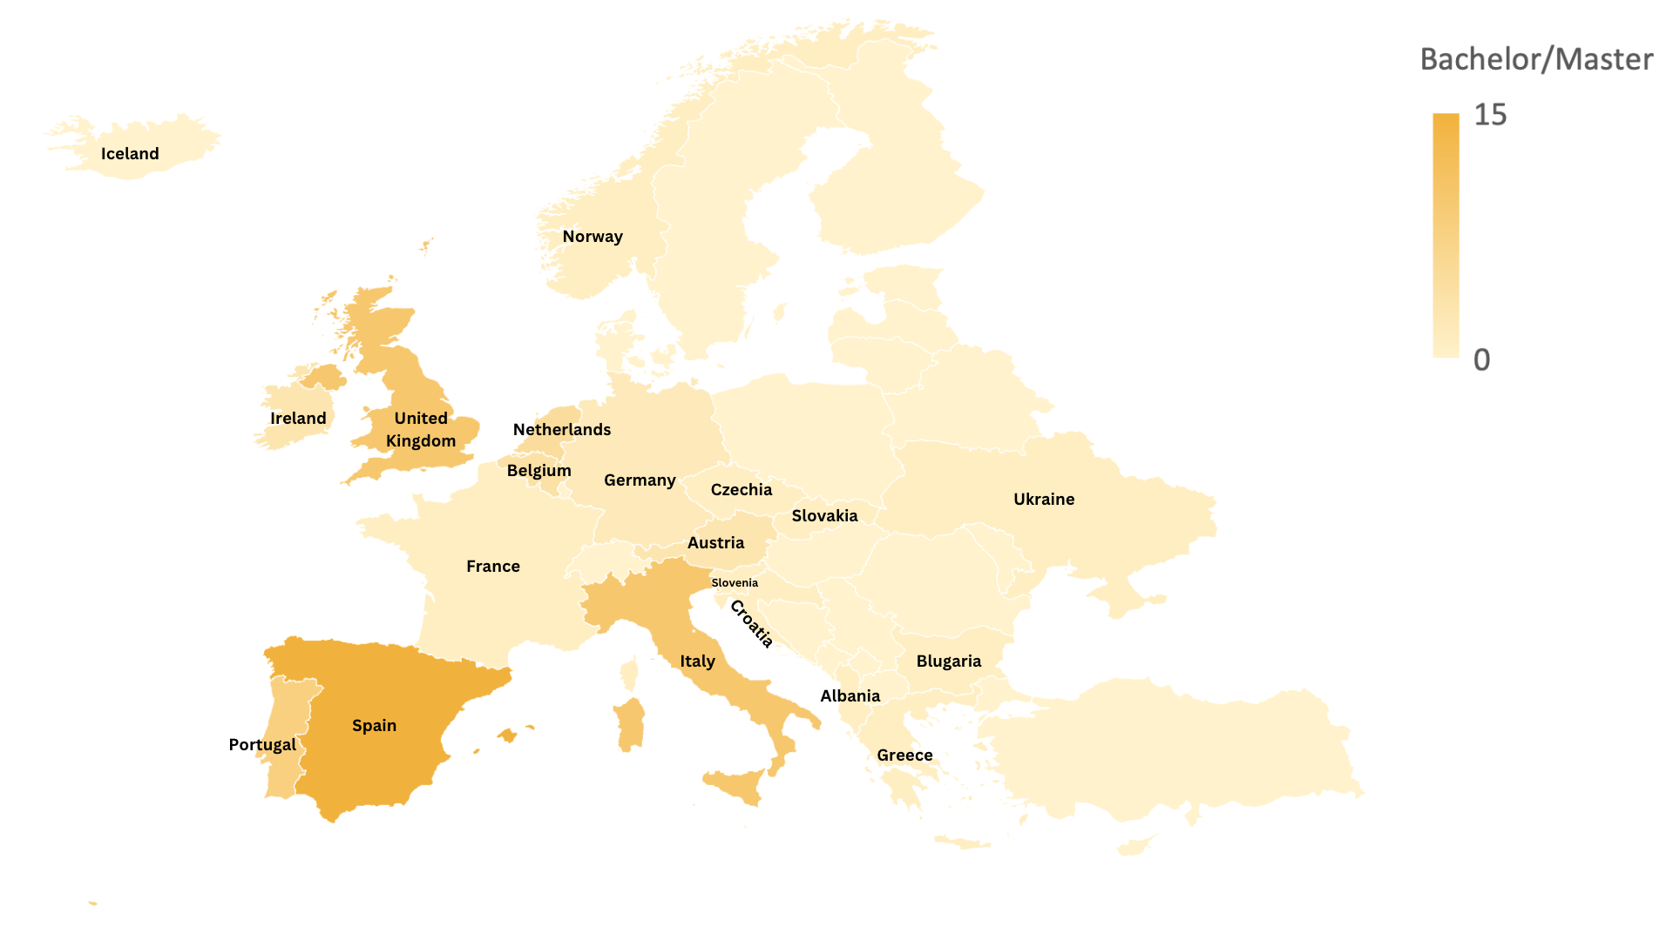
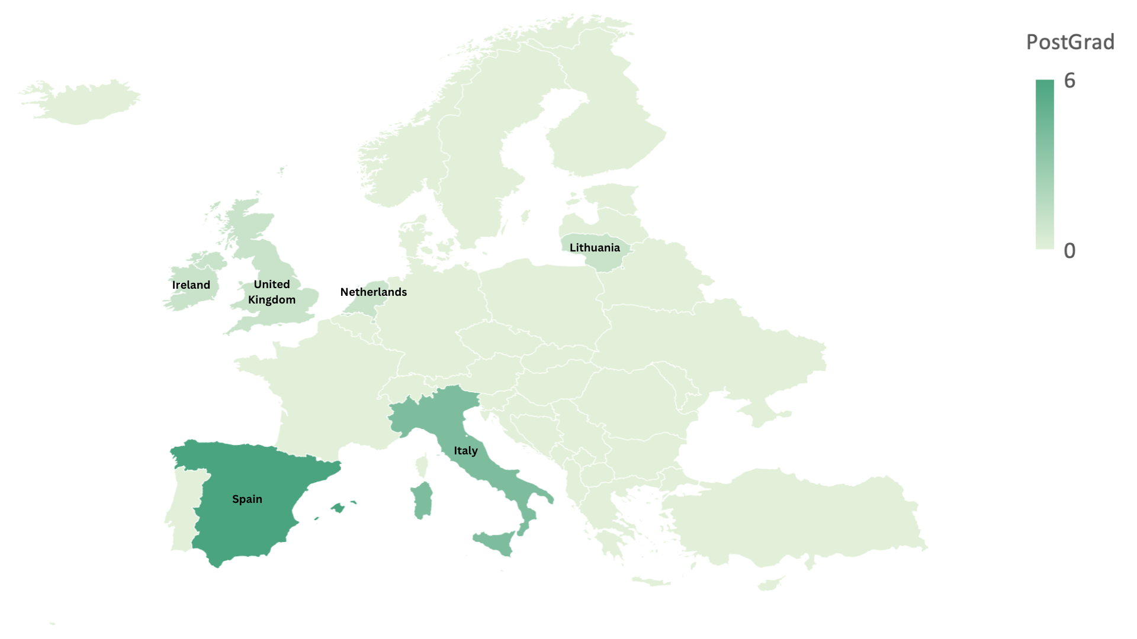
Results - Mapping
Bachelor Master Course Mapping
Post Graduate Course Mapping
    total of 74 programs found in 23 countries at University level (UL)
    total of 15 programs found in 7 countries at Post Graduate level (PGL)
    Spain was the country with the highest number of programs (15 UL/6 PGL) followed by Italy (10 UL/4 PGL)
    Top 15 based on 3 rankings and 5 SFS education programs
Notes:
Note, the top 15 is not shown yet in the maps, as we are still finalizing the survey answers and curricula research
Currently, food education at the university level is often narrowly defined with courses and specialties limited by a specific topic e.g., Nutrition or Agro-economy. At lower educational levels, lessons on food and sustainability are likely not part of national curricula but may be implemented by individual schools or instructors. This deliverable has the goal of contributing to the creation of a branded network of EU university-driven local ecosystems by reviewing best practices and barriers in sustainable food systems (SFS) education at all levels. Three steps were followed here: i) a desk study identified educational programs in SFS and personnel involved in them, ii) a series of workshops gathered best practices and barriers to SFS education and included ideas for research and innovation solutions, and iii) an analysis of independent rankings of university programs and practices. Researching European school programs in SFS from 2018 through present and at all educational levels – Elementary, Secondary, Bachelor, Master, Postgraduate (PostGrad) and Lifelong Learning (LLL) - showed that most SFS programs at the Bachelor/Master/PostGrad level were in Spain, Italy and UK. Face-to-face and online workshops with educational personnel identified most university level best practices in the Teacher Skills and Capacity (18) and most barriers were related to Students, primarily student motivation (11). Research and innovation solutions included 65 ideas and two particular programs currently in progress (Ecotrophelia and Uniworld) were identified as favourite examples of SFS education by the workshop participants. Results of this three-part study suggest that most education about SFS is taking place at the University level in Europe but there may, however, be a lack of specialization possibilities as few PostGrad programs exist. Both the desk analysis of current SFS programs and the ranking analysis of universities showed three European countries which appear to stand out in SFS education, Spain, Italy, and the UK. Here, a closer look at best practices, particularly relating to student motivation, which was identified as a leading barrier, could be useful. Additionally, the role of these universities in driving sustainability practices in their ecosystems may be applicable throughout Europe. Finally, current LLL practices of unified online offerings may be applicable to developing a branded European network of universities.

Slide 5
Results - Drivers
  Distribution of driver ideas for SFS education at the University (Bachelor/Master) level and across seven transition categories
  The most important in quality of SFS education seems to be strengths of people involved
  i.e., the skills of teachers and the motivation of students
  “Try and keep interests’ level high”
  “genuine interest”
  “peer observation, action-learning, problem-solving, professors are part of the food city council”
  “Exchange programmes among teachers – learning about online courses”

Slide 6
Comparing universities
Mapping via sustainability scores,
Surveys and interviews,
Comparing curricula, sustainability charts, interaction with ecosystem
Receiving input from ICA,
  Leading universities on curricula,
  Leading universities on sustainability,
CleverFood project, FOSSNET
HEI network from EIT Food & Master of sustainable food systems,
Notes:
What do we mean with branded

Slide 7
Preliminary findings survey
Food systems approach (eg. food waste management system and sustainable food options available) in campus is not widelyspread
approach is present in bachelor and master studies, but less at lifelong learning programs
definition is known but not always well placed in curricula
CSR
community gardens, demonstration sites, intership programmes are important part of teaching
Sustainable Food Systems
CSA (Climate Smart Agriculture) practices (farm or box scheme) are already in teaching, but not aligned with wider SFS approach
not many Universities have a corporate social responsibility programs, follow a specific standard or label (e.g., ISO 26000) or have action plan aimed at achieving the SDGs
systemic approach
requires cooperation and continuous communication with business - (1) reporting on training and skills needs in the SFS (2) indicating trends and public policy frameworks (EU and national) for the development of the SFS to companies
Notes:
Findings following the survey, desk research and interviews regarding Corporate practises and organisation and Curricula

Slide 8
Preliminary recommendations
Principles, rules, law to support internal organisation and corporate practises
Fostering multicator cooperation on curricula and accreditation (business-science-policy)
Identification of needs from business and their proper understanding of SFS transformation; innovations, trends, EU/national policy that influences economy transformaton
Universities learn from each other –
networking and good practises on SFS education in practise
Notes:
Systemic approach related to food systems transformation represented at the University level:
Principles, rules, law to support internal organisation and corporate practises
fostering multicator cooperation on curricula and accreditation (business-science-policy)
Ensure and operationalize communication channels to ensure proper identification of needs from business and their proper understanding of SFS transformation: innvations, trends, EU/national policy that influences economy transformaton.
research, cooperation best practises helping to understand SFS approach to stimulate the University-driven local ecosystems,

Slide 9
Thank you!
Questions
www.foodpaths.eu
SciFoodHealth
SciFoodHealth
Sustainable Food Systems Network

